Slide 1

Genome mapping
Axel LEVY
Corentin SOUBEIRAN
March 2022
INF589 - Computational analysis of high-throughput sequencing data

Slide 2

Why mapping genome ?

Slide 3
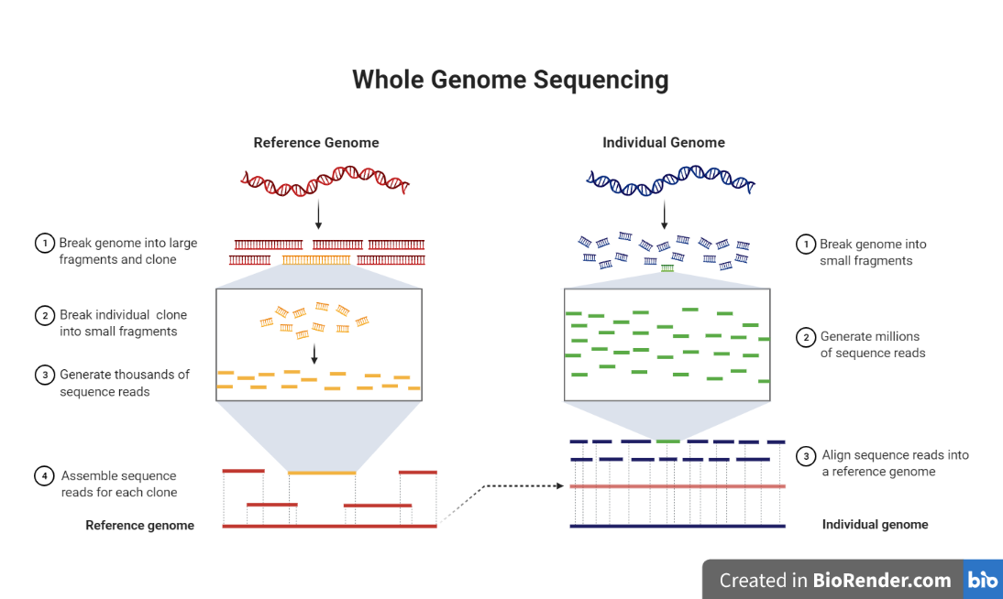
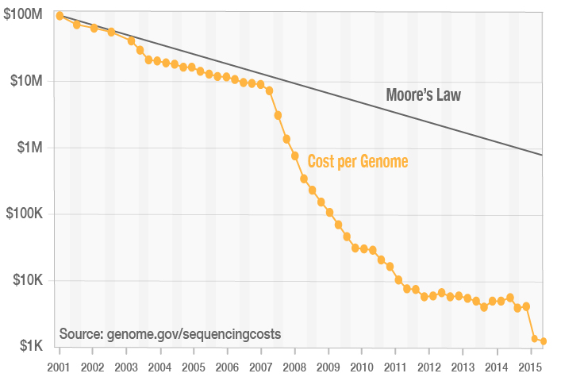
Why mapping genome ?
Main idea: capitalize on knowledges
Reduce drastically the computations and the cost

Slide 4

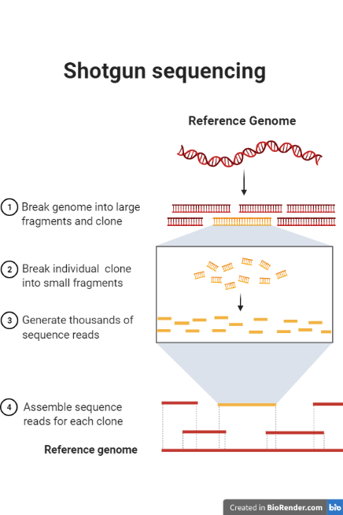
Why mapping genome ? - Example
Without mapping:
Genome length: 1000b
Fold: 5
Read length 100 (std=50)
Computation time: 84ms
With mapping:
Genome length: 1000b
Fold: 1
Read length 100 (std=50)
Computation time: 8ms

Slide 5

How to map genome ?

Slide 6
Prefix trees
Advantages:
Drawback:

Slide 7
Prefix tries
Advantages:
Drawback:

Slide 8
Sufix tries
Advantages:
Drawback:

Slide 9
Suffix array
Advantages:
Drawback:

Slide 10


Burrows-Wheeler transform
= a pre-processing used in data compression
$bananas
s$banana
as$banan
nas$bana
anas$ban
nanas$ba
ananas$b
bananas$
$bananas
ananas$b
anas$ban
as$banan
bananas$
nanas$ba
nas$bana
s$banana
b
a
n
a
n
a
s
$
BWT
sbnn$aaa
Cyclic rotations $(O(n))$
Sorting $O(nlog(n))$

Slide 11
Burrows-Wheeler transform
= a pre-processing used in data compression
First
Last
$bananas
s$banana
as$banan
nas$bana
anas$ban
nanas$ba
ananas$b
bananas$
$bananas
ananas$b
anas$ban
as$banan
bananas$
nanas$ba
nas$bana
s$banana
b
a
n
a
n
a
s
$
Trace back a sequence from last letter to first
Cyclic rotations $(O(n))$
Sorting $O(nlog(n))$

Slide 12
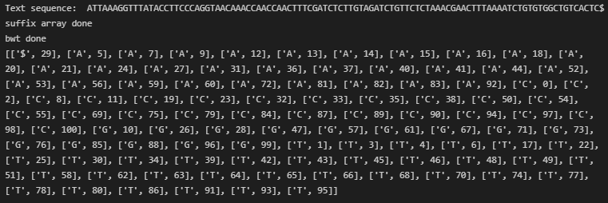
Burrows-Wheeler transform
= a pre-processing used in data compression
First
Last
$bananas
s$banana
as$banan
nas$bana
anas$ban
nanas$ba
ananas$b
bananas$
$bananas
ananas$b
anas$ban
as$banan
bananas$
nanas$ba
nas$bana
s$banana
b
a
n
a
n
a
s
$
Cyclic rotations $(O(n))$
Sorting $O(nlog(n))$

Slide 13
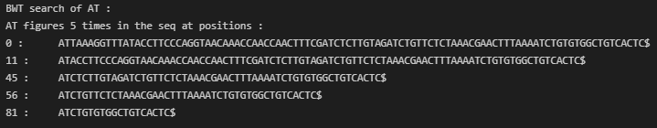
Burrows-Wheeler transform
= a pre-processing used in data compression
First
Last
$bananas
s$banana
as$banan
nas$bana
anas$ban
nanas$ba
ananas$b
bananas$
$bananas
ananas$b
anas$ban
as$banan
bananas$
nanas$ba
nas$bana
s$banana
b
a
n
a
n
a
s
$
Cyclic rotations $(O(n))$
Sorting $O(nlog(n))$

Slide 14

Results

Slide 15
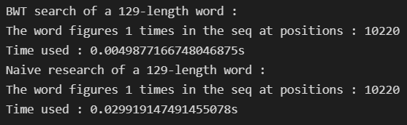
BWT search vs Naive search

Slide 16
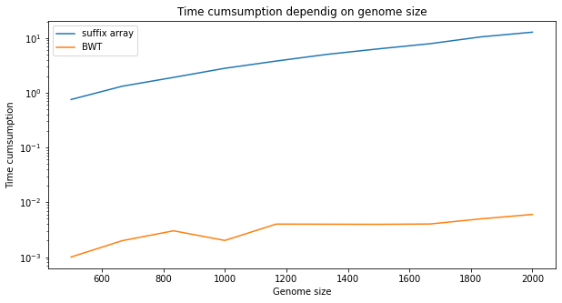
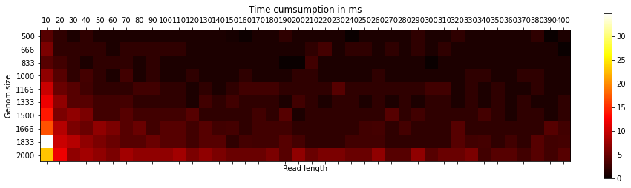
Simple implementation
Sublinear complexity (nlogn)
Short read length increase complexity because more probability to have different choices and more comparsions

Slide 17
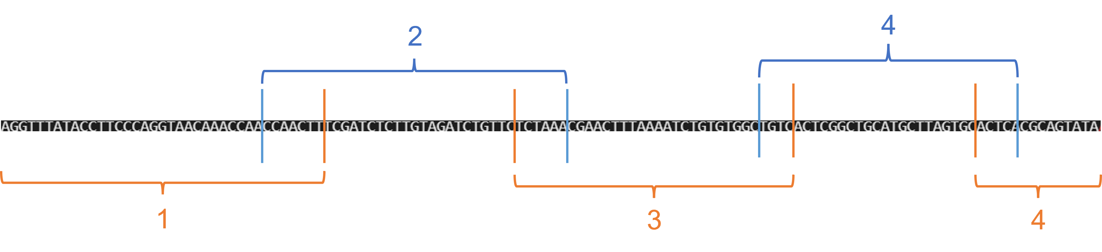
Issue : memory consumption
Suffix array : memory in O(n!) -> unpossible to compute for n>2000…
2 Parameters : Length and Overlap

Slide 18
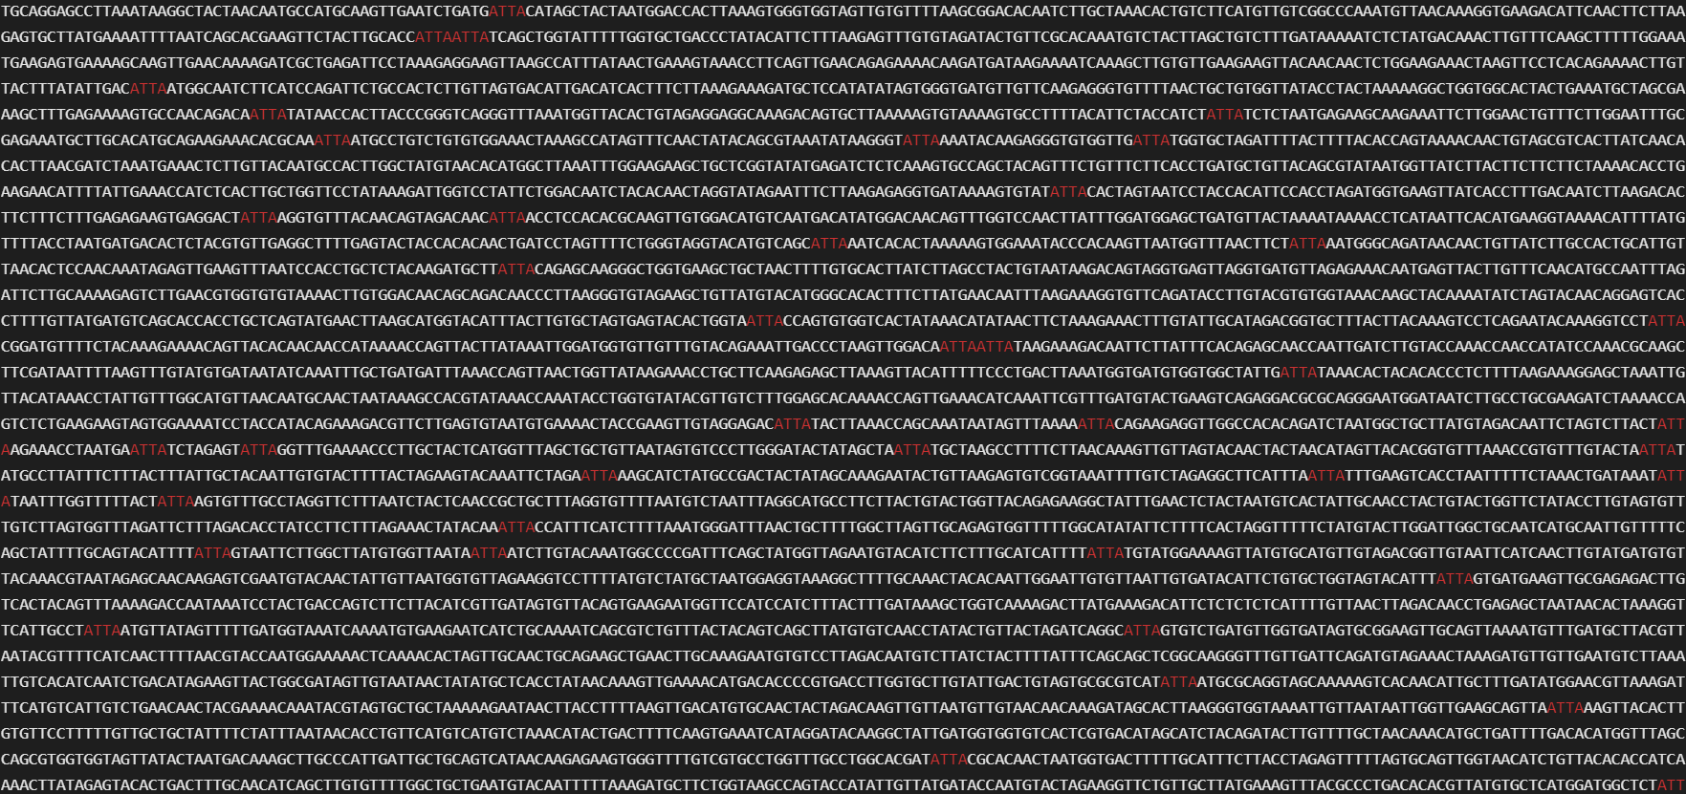
Search « ATTA » in a 10000 length sequence

Slide 19

Conclusion and perspectives

Slide 20
Conclusion and perspectives
Add errors or mutations: quantify sequence and read matching

